Slide 1
Define a variable and write each phrase as an algebraic expression
Problem One Six feet less than the width | Problem Two Four times more money than Elliot

Slide 2
Define a variable and write each phrase as an algebraic expression
Problem Three Half as many pages as George | Problem Four Six years less than Tracey’s age

Slide 3
Define a variable and write each phrase as an algebraic expression
Problem Five The cost of 5 CDs and a $12 DVD | Problem Six Four times as many apples

Slide 4
Define a variable and write each phrase as an algebraic expression
Problem Seven Ten more shoes than Ruben | Problem Eight $5 dollars less on dinner than James spent

Slide 5
Define a variable and write each phrase as an algebraic expression
Problem Nine 3 more than twice as many ringtones as Mary | Problem Ten 12 times the number of feet

Slide 6
Define a variable and write each phrase as an algebraic expression
Problem Eleven
Melinda goes bowling on Saturday afternoons. She bowls three games and pays for shoe rental. Define a variable and write an expression to represent the total cost of Melinda pays. Then find the total cost if one game cost $4.

Slide 7
Define a variable and write each phrase as an algebraic expression
Problem Twelve
Kiyo bought a pizza for $12.75 and four medium drinks at Pauli’s Pizza. Define a variable and write an expression to represent the total amount of money he spent. Then find the total cost if one drink costs $3.

Slide 8
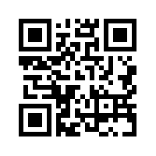
Define a variable and write each phrase as an algebraic expression
Problem One Answer | Problem Two Answer

Slide 9
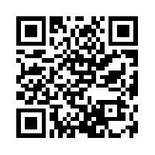
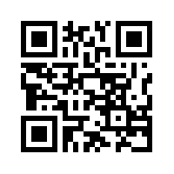
Define a variable and write each phrase as an algebraic expression
Problem Three Answer | Problem Four Answer

Slide 10
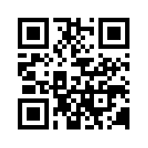
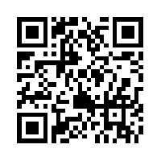
Define a variable and write each phrase as an algebraic expression
Problem Five Answer | Problem Six Answer

Slide 11
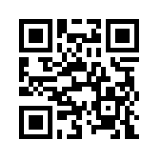
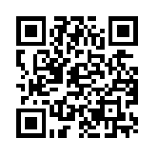
Define a variable and write each phrase as an algebraic expression
Problem Seven Answer | Problem Eight Answer

Slide 12
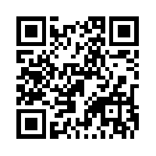
Define a variable and write each phrase as an algebraic expression
Problem Nine Answer | Problem Ten Answer

Slide 13
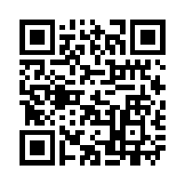
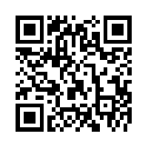
Define a variable and write each phrase as an algebraic expression
Problem Eleven Answer | Problem Twelve Answer

